Slide 1
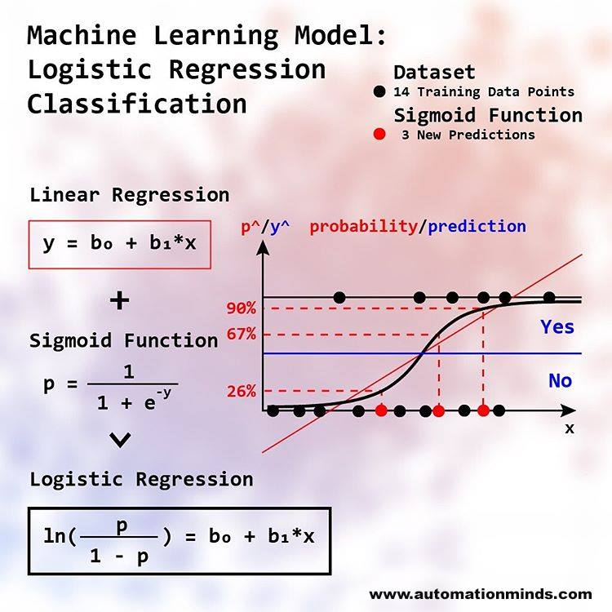
Binary Logistic Regression
For the given data, build a Logistic Regression model to find out the key variables which significantly explains the probability of ‘Default_On_Payment’.
Presented by-DIPANKAR SANTRA

Slide 2
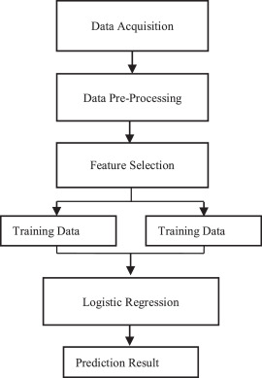
STAPES OF Logistic Regression

Slide 3
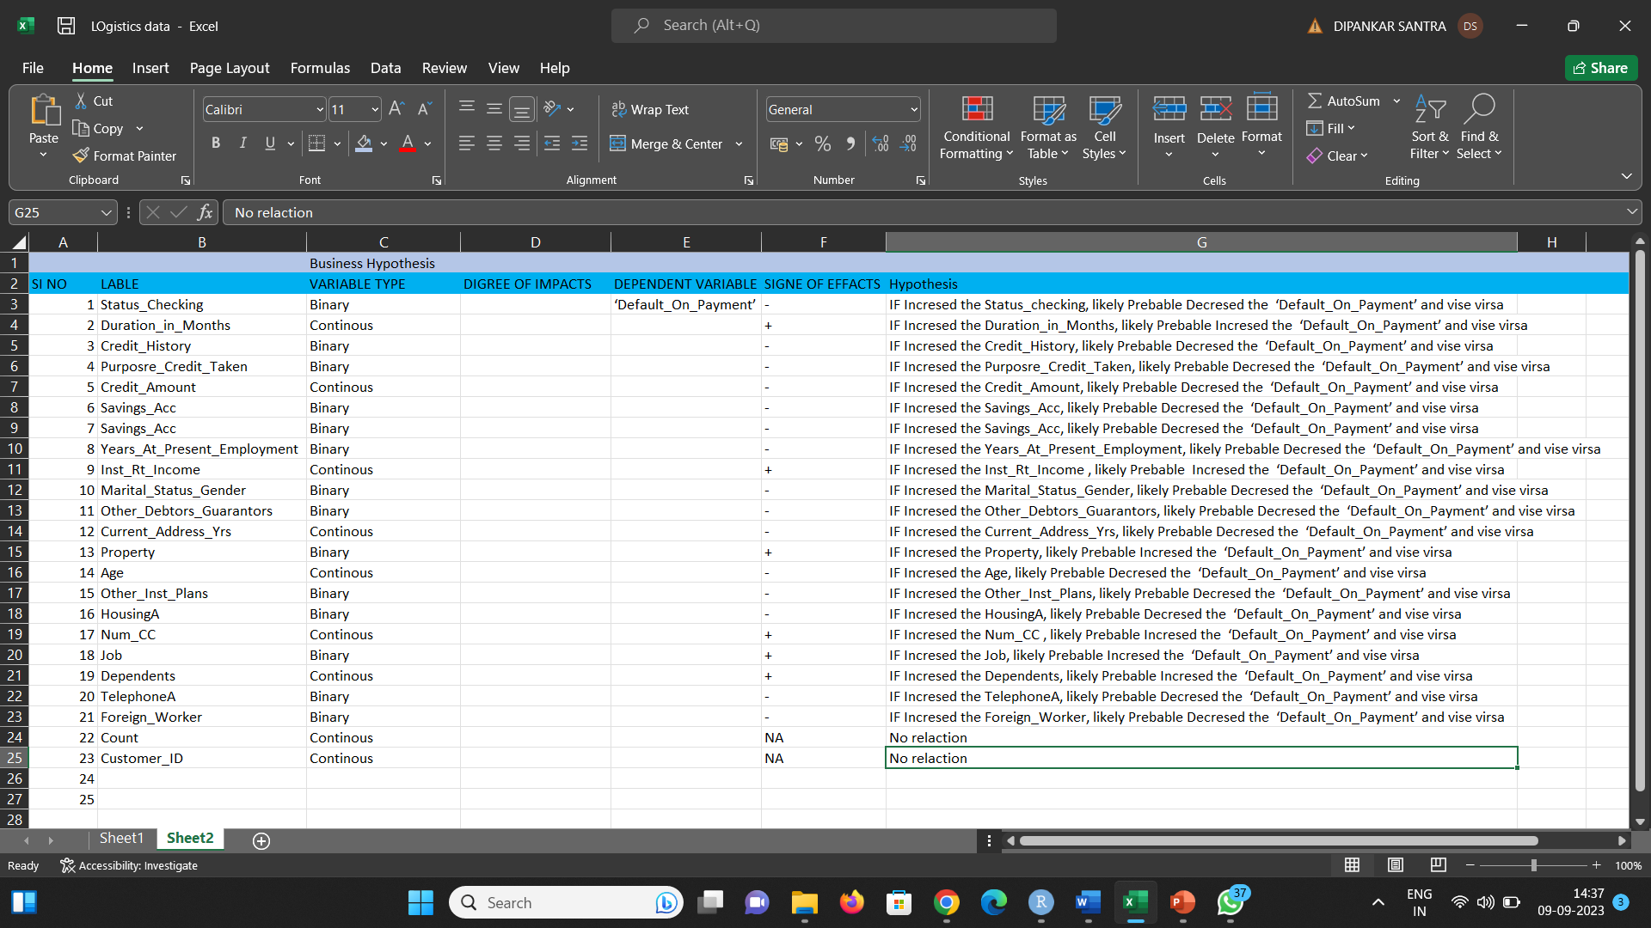
Hypothesis formulation

Slide 4
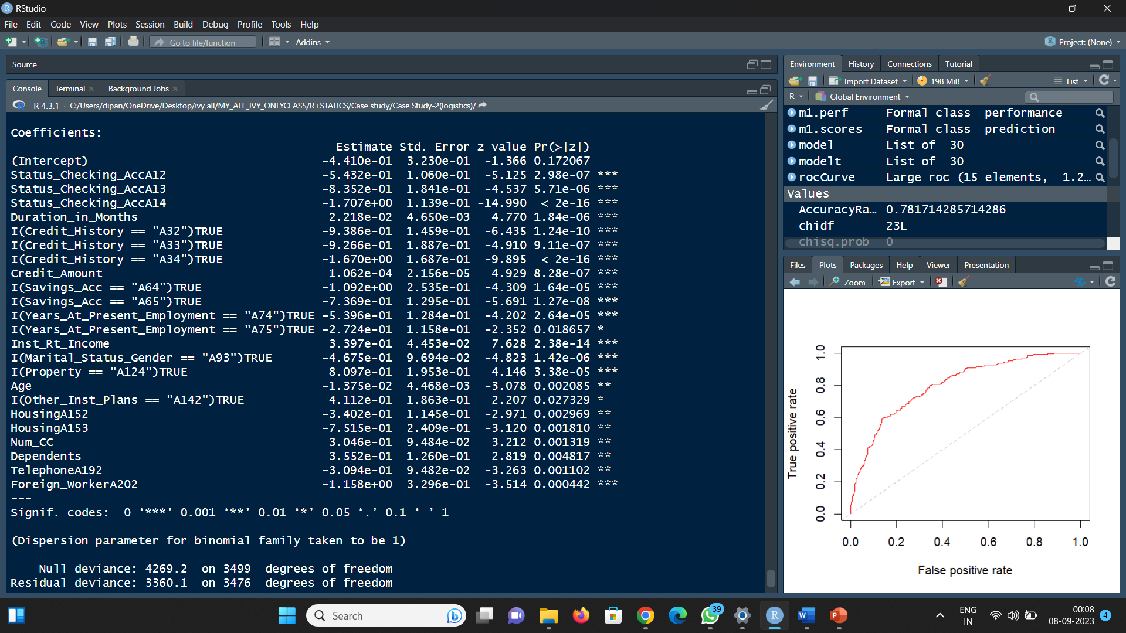
Train data P value calculation

Slide 5
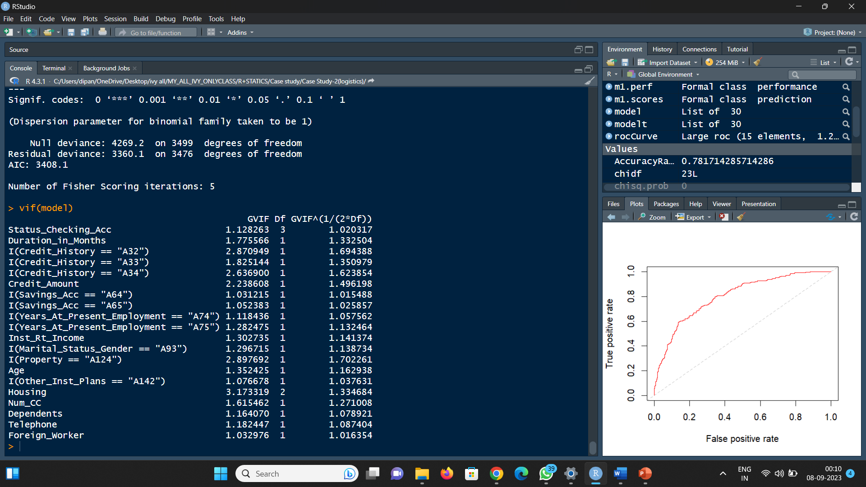
Train data multi collinearity calculation

Slide 6
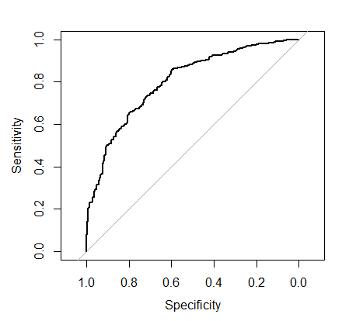
Sensitivity vs Specificity Area curve
Confusion Matrix
Actual
0 1
0 2110 420
Predicted 1 344 626

Slide 7
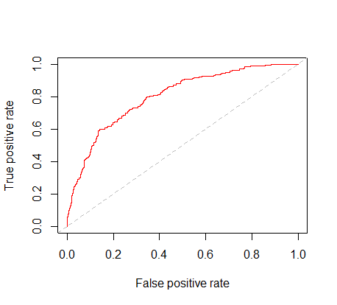

Slide 8
Test dataset

Slide 9
Thanks you

